Slide 1
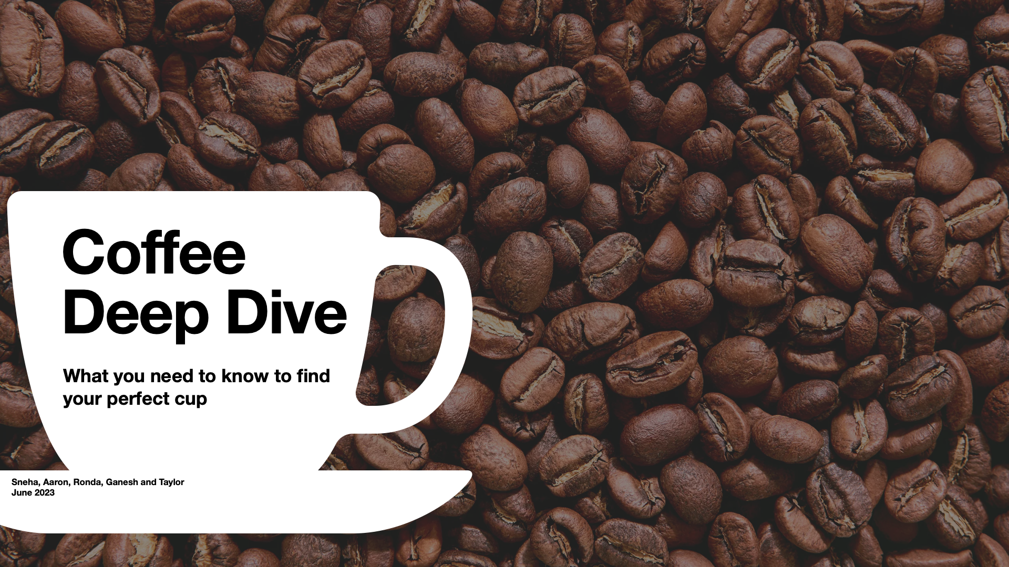
What is “Good” Coffee?
Group 8:
Aaron R, Ganesh Vasu, Ronda Hinz, Sneha Thomas, Taylor Ward

Slide 2

Contents
Coffee Quality Dataset
World’s “Best” Coffee
Colombian Coffee Buzz
Processing Methods vs. Coffee Quality
Arabica vs. Robusta
Key Takeaways

Slide 3

Coffee Quality Dataset

Slide 4
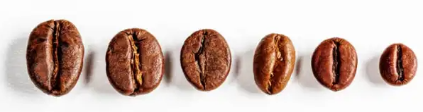
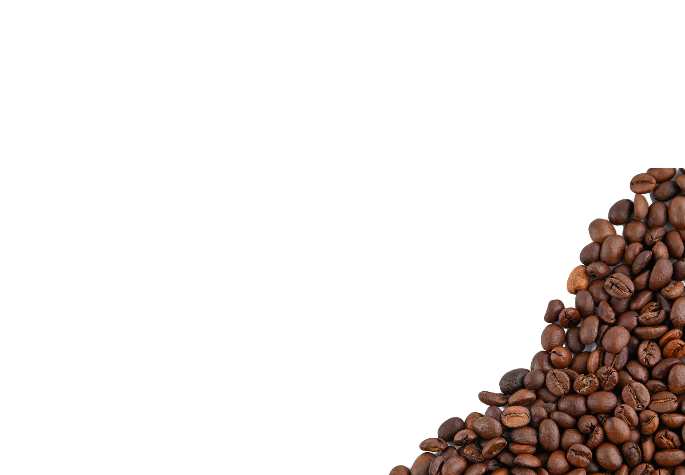
About the Data
The dataset used in this analysis includes coffee beans harvested from 35 countries between 2008 and 2018.
Beans were submitted to the Coffee Quality Institute (CQI) for professional evaluation by a panel of coffee connoisseurs. Each submission is assigned a coffee quality score (10-point scale) for each of the following categories:
Aroma: Refers to the scent or fragrance of the coffee.
Flavor: Preferred taste including any sweetness, bitterness, acidity, and other flavor notes.
Aftertaste: Refers to the lingering taste that remains in the mouth after swallowing.
Acidity: Brightness or liveliness of the taste.
Body: Thickness or viscosity of the coffee in the mouth.
Balance: How well the different flavor components of the coffee work together.
Uniformity: Consistency of the coffee from cup to cup.
Clean Cup: Free of any off-flavors or defects, such as sourness, mustiness, or staleness.
Sweetness: Described as caramel-like, fruity, or floral. (Deemed to be a desirable quality!)
Accompanying metrics include:
Location beans were harvested
Altitude of harvest
Variety of bean
Method of processing

Slide 5

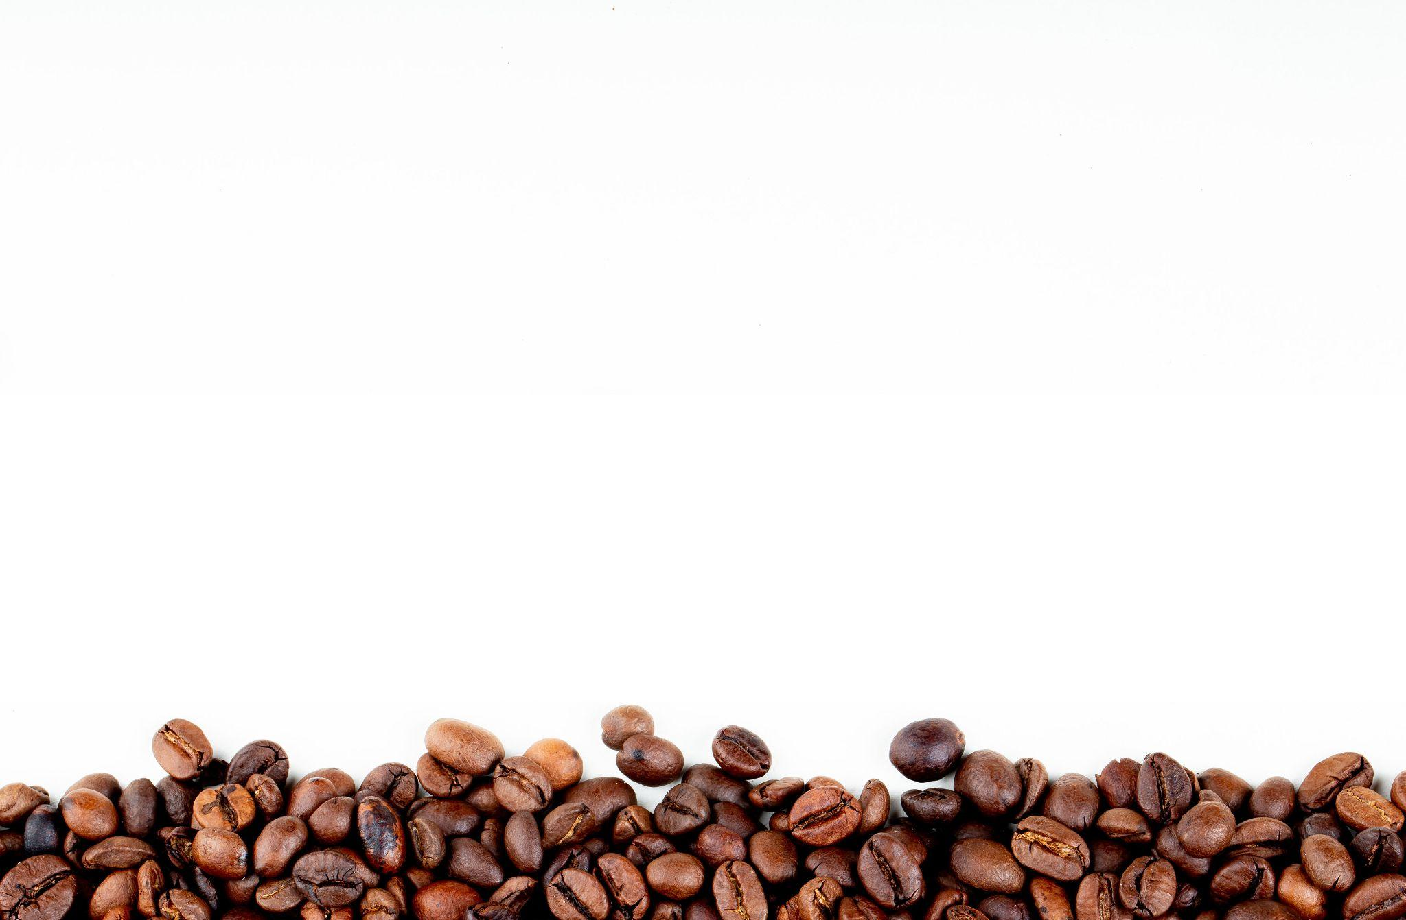
Source Material & Citations
Our working dataset was downloaded from Kaggle.com in .csv format with credit given to Diego Volpatto, Kaggle Contributor, for publishing the merged dataset for public use.
Volpatto on Kaggle: ttps://www.kaggle.com/datasets/volpatto/coffee-quality-database-from-cqi
Honorable mentions:
Campground APIs: https://developer.active.com/docs/read/Campground_APIs
Animal Shelter data: https://data.sonomacounty.ca.gov/widgets/924a-vesw

Slide 6
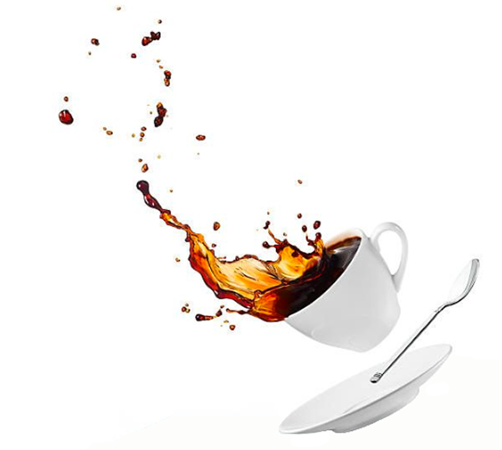
Data Cleaning & Formatting
One of the reasons we chose this project is because the dataset appeared comprehensive and CLEAN but, ultimately, we were disappointed on both fronts.
Source data included information for both Arabica and Robusta beans.
Comprising only 2% of the total dataset, the Robusta data was
not as “robusta” as we had initially hoped.
We discovered numerous gaps (i.e. blanks) in the dataset and a significant number of inconsistencies with how the data was recorded. Our solutions:
Formatting anomalies are salvageable. Example:
Altitude: “1200 meters”, “1200m”, “1200+ meters above sea level.” = 1200
Content errors are dropped. Example:
Country: “United States” | Region: “central america” = DROP ROW
FACT: Our Python code includes 78 instances of <.replace> dedicated solely to correcting spelling errors and foreign word translations associated with “Region” (column header)

Slide 7
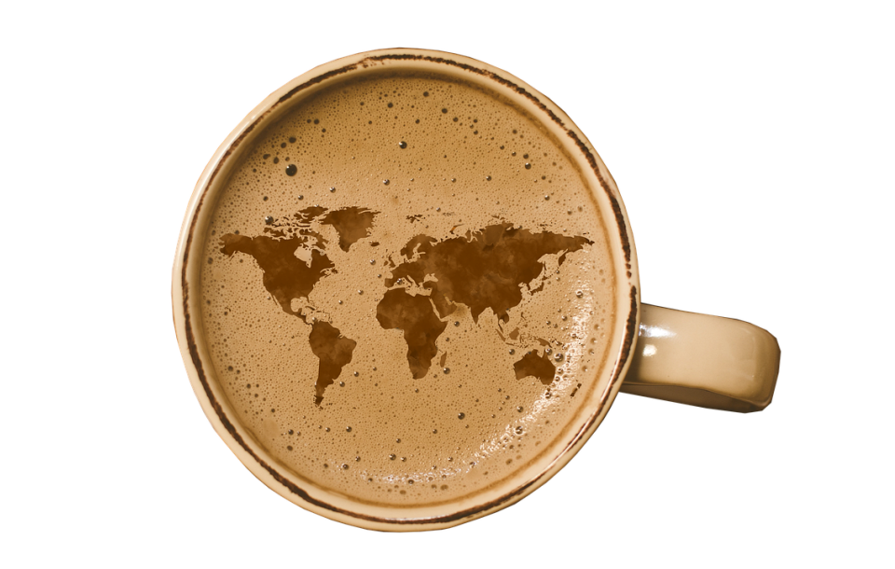
World’s “Best” Coffee

Slide 8
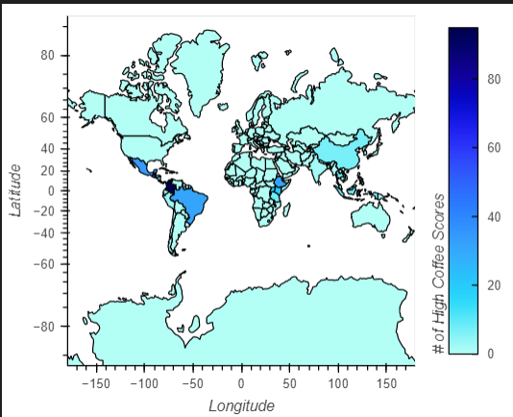
Where’s the Good Stuff?
The darker the blue, the better the brew!
← A distribution of “High” overall coffee scores across the world

Slide 9
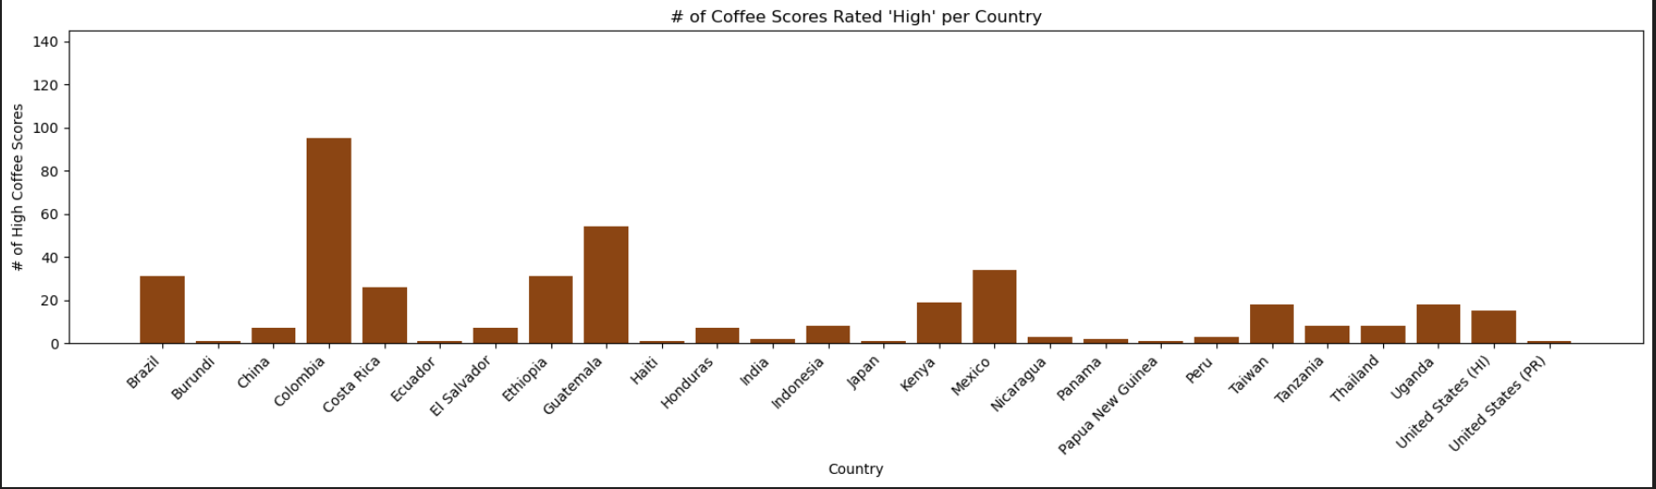
Colombia sets the bar high!

Slide 10
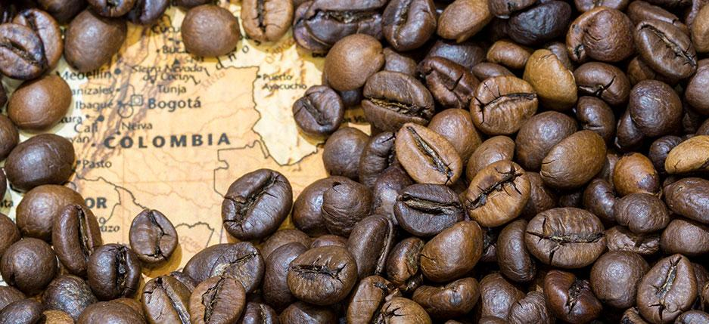
Colombian Coffee Buzz

Slide 11
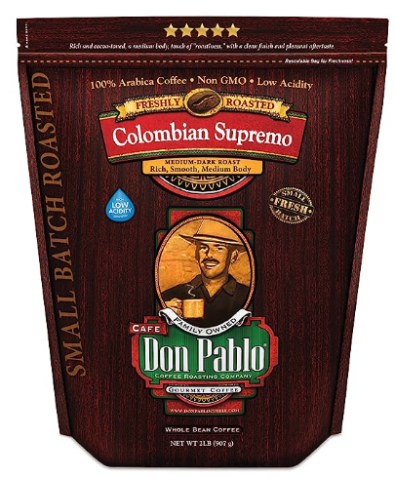
Is Colombian coffee really that different?
“Colombian or Colombia coffee is a distinct type of arabica coffee that has maintained notoriety for its classic taste, excellent quality, and national history.”
-thecoffeeadvice.com
“Colombia has a distinct climate that is ideal for coffee cultivation, with an ideal range of temperatures and just the right amount of rainfall
“Another important factor that contributes to the high quality of Colombian coffee is the country's unique processing methods. For centuries, Colombian coffee farmers have used traditional processing methods such as washing and sun-drying the coffee beans.”
“As a result, the coffee is cleaner, more flavorful, and defect-free.”
-finalgrind.com

Slide 12
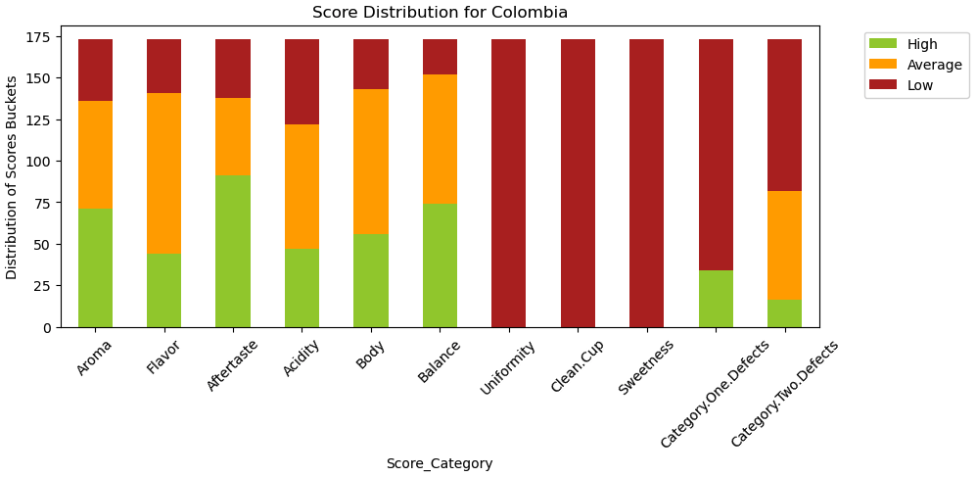
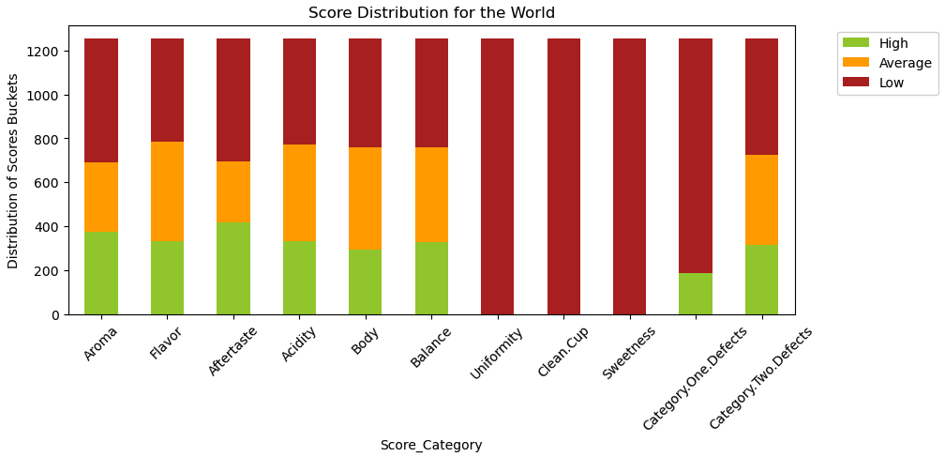
Score distributions for Colombia do look different but are they significant?

Slide 13
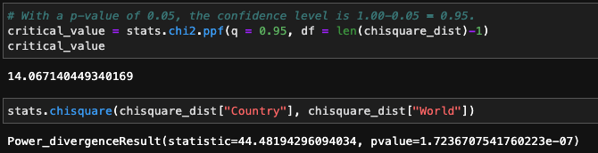
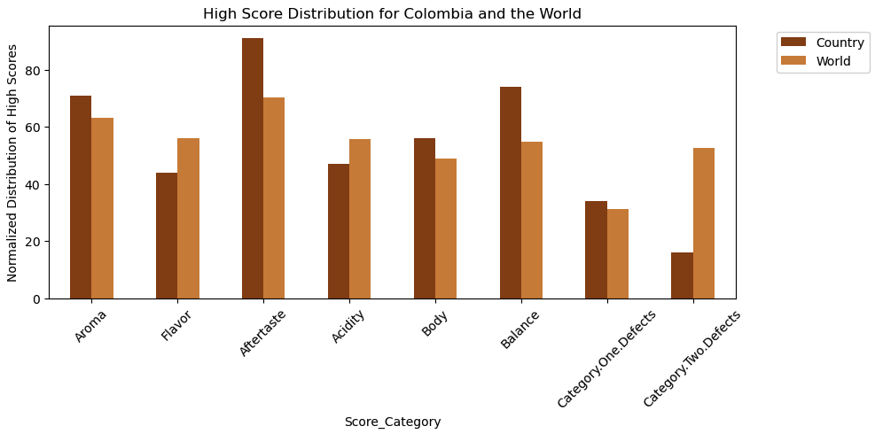
The distribution of high coffee scores in Columbia is, in fact, significantly different from the world!
A chi-square test was performed on the distribution of “high” scores across various coffee quality metrics for Colombia and the World.
The Chi-Square statistic for Colombia is higher than critical value leading to a low p-value.
Hence, we accept the alternate hypotheses that the distribution of high scores in Colombia is indeed different and significant.

Slide 14
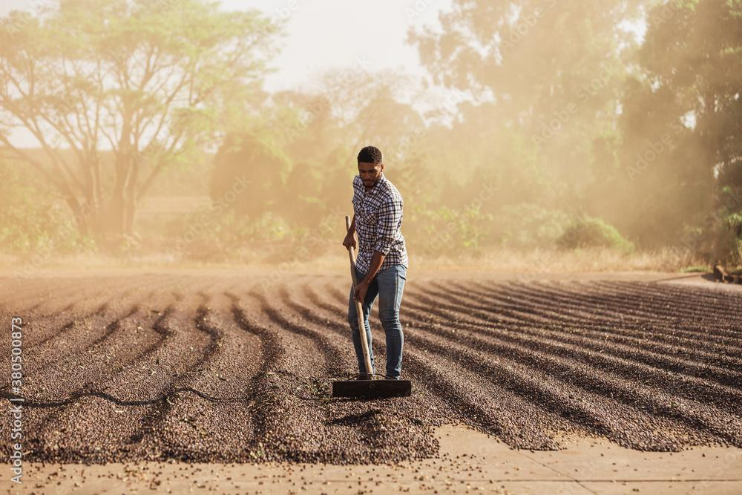
Processing Methods vs. Coffee Quality
Notes:
Does processing method significantly impact the distribution of a coffee flavor, aroma or body?

Slide 15
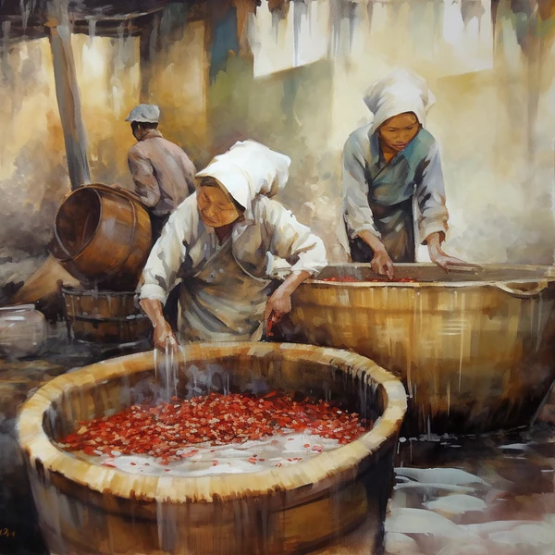
Wet or dry coffee processing - does it matter?
“Processing method has a big impact on a coffee's flavor, aroma, and body.”
-perfectdailygrind.com
“As a specialty coffee lover, you might have heard about coffee processing, but do you know how it influences the flavor of your favorite cup of coffee? The truth is that coffee processing can significantly impact the final product's taste, aroma, and overall quality.”
-third-wave.coffee.com
“There are various factors affecting coffee quality among which processing methods is one...The 60% of coffee quality is determined by this primary and secondary coffee processing.”
-Banti, M., & Abraham, E. (2021). Coffee processing methods, coffee quality and related environmental issues. Journal of Food and Nutrition Sciences, 9(6), 144. https://doi.org/10.11648/j.jfns.20210906.12

Slide 16
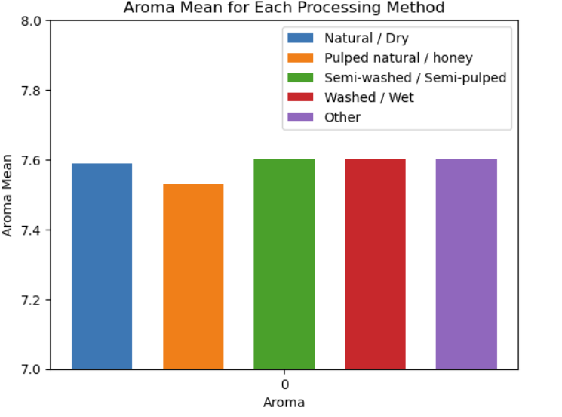
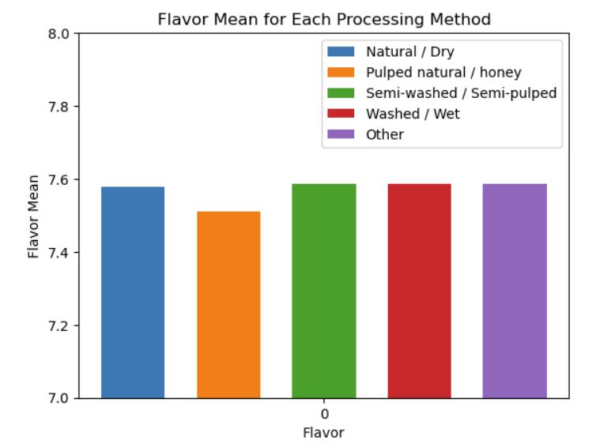
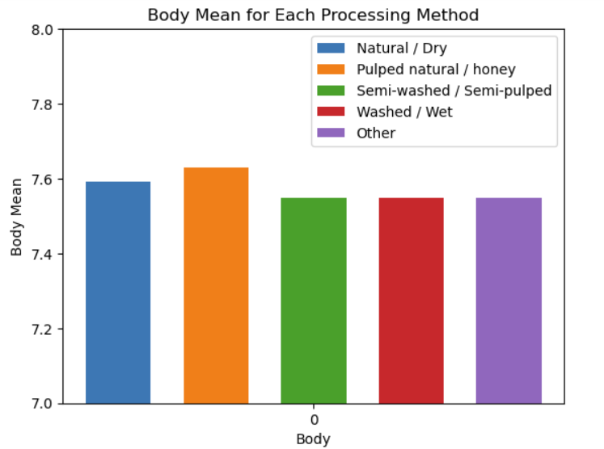
Aroma/Flavor/Body Means by Processing Method

Slide 17
With scores so close, it’s difficult to tell if processing methods had an impact.
We decided to perform a series of ANOVA tests to find out.

Slide 18
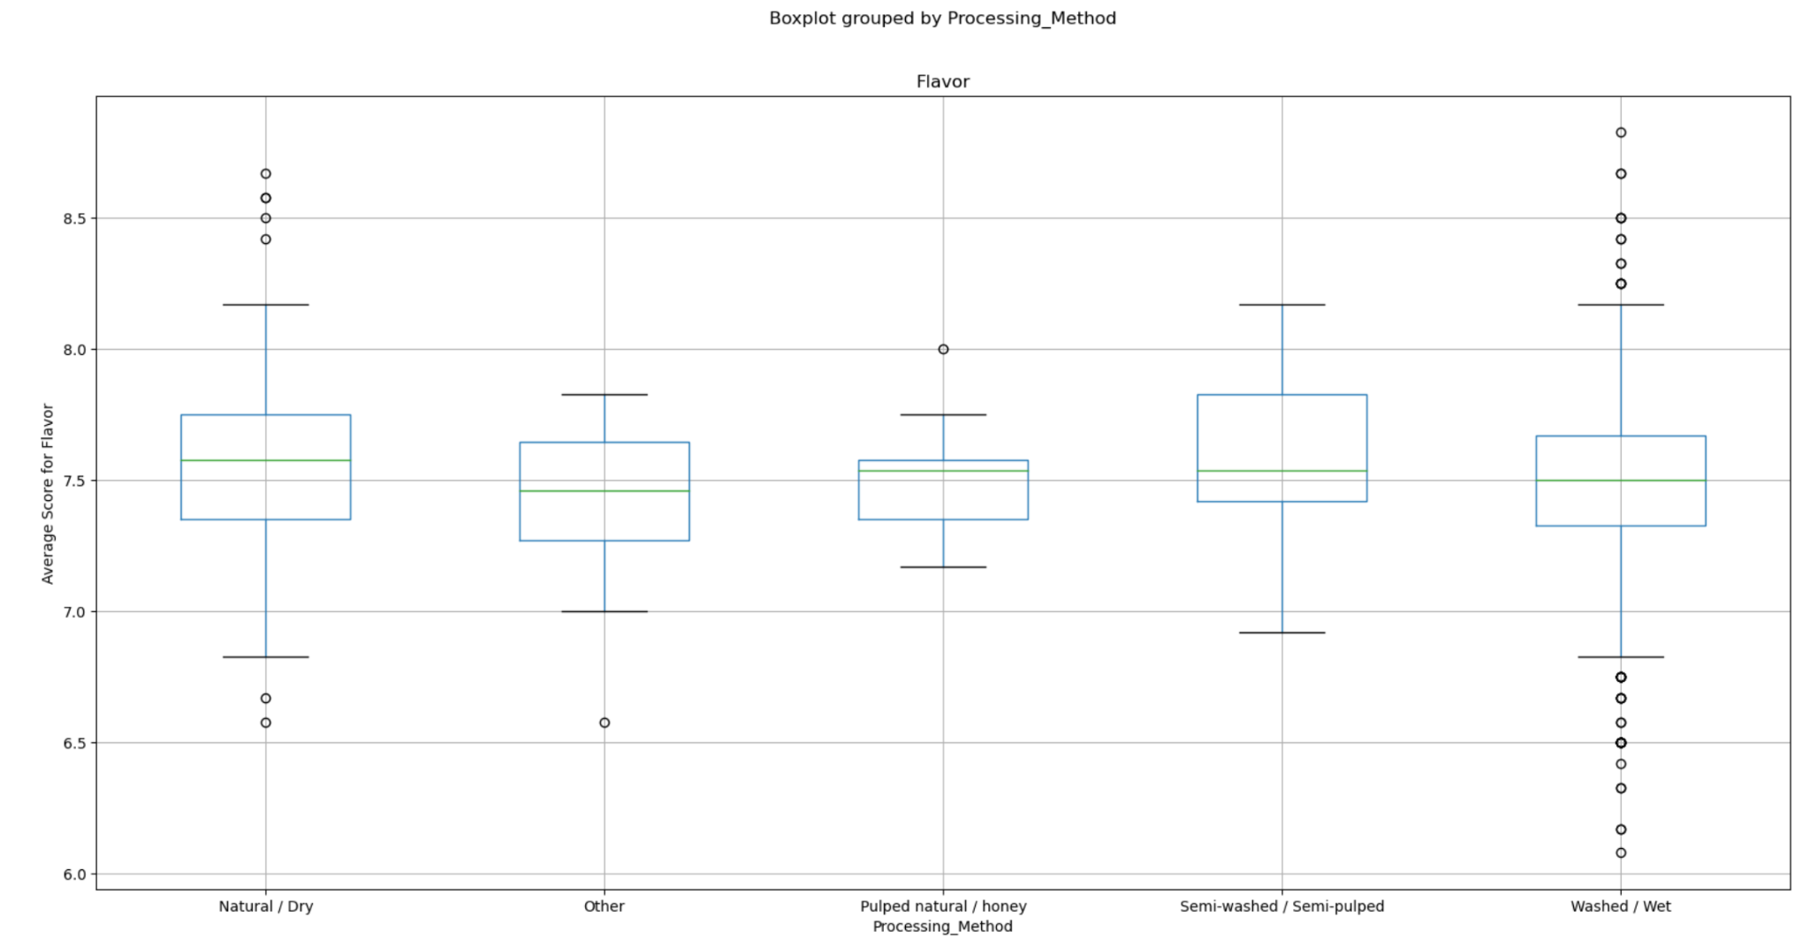
Yes! Processing method impacts coffee flavor
With a p-value of less than 0.05, we can reject our null hypothesis that processing method does not impact coffee flavor
pvalue=
0.0007457874514009814
Notes:
The p-value is small enough that we can reject the null hypothesis
Null hypothesis: Processing method has no impact on a coffee flavor
Alt hypothesis: Processing method has significant impact on coffee flavor

Slide 19
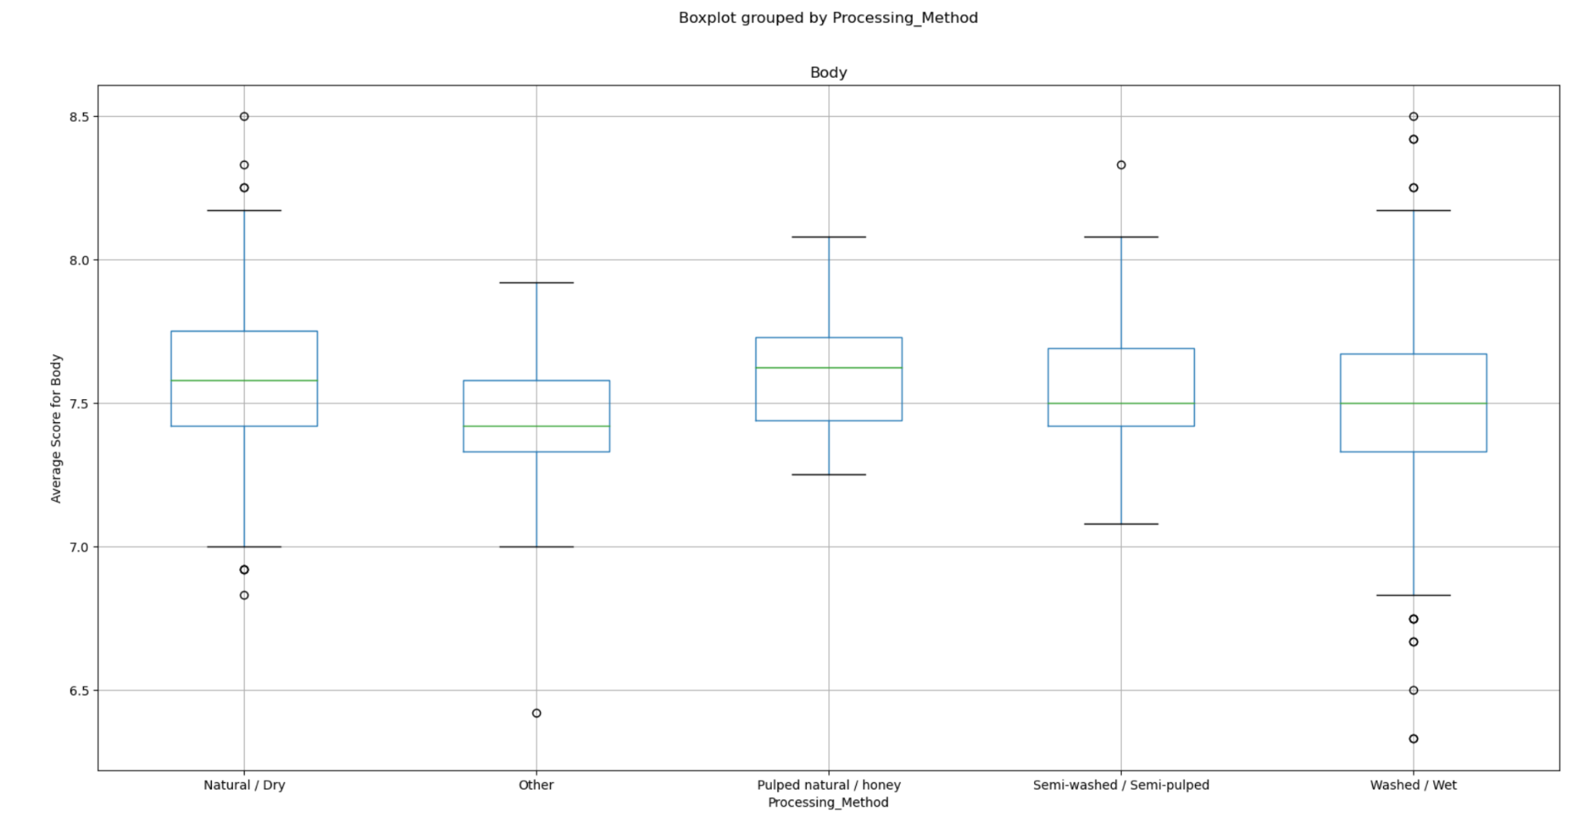
Yes! Processing method impacts body
With a p-value of (much!) less than 0.05 we can reject the null hypothesis that processing method does not impact the body of coffee
pvalue=
1.2368895749915461e-06
Notes:
The p-value is very small, thus the impact of processing method’s impact on the body of coffee is very significant, and we can reject the null hypothesis

Slide 20
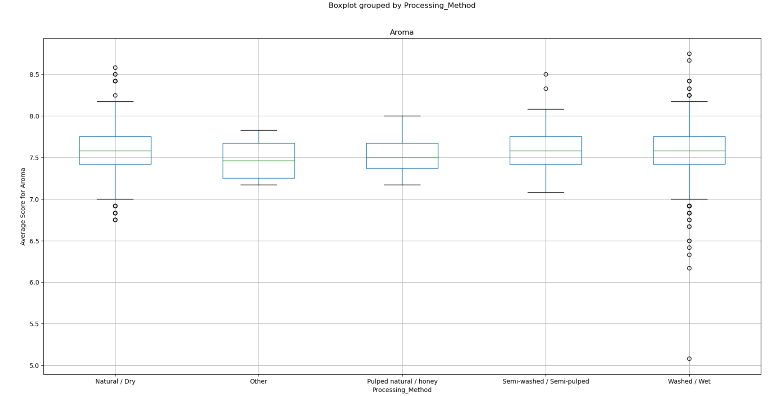
No! Processing method does not impact aroma
With a p-value of greater than 0.05, we accept the null hypothesis that processing method does not impact coffee flavor
pvalue=
0.1948126243804556
Notes:
The p-value is large enough that we have to accept the null hypothesis
Null hypothesis: Processing method has no impact on a coffee aroma
Alt hypothesis: Processing method has significant impact on coffee aroma

Slide 21

Arabica vs. Robusta
Notes:
It also turns out that there are only two species of coffee in the world, and so we wanted to know - what’s the difference?

Slide 22
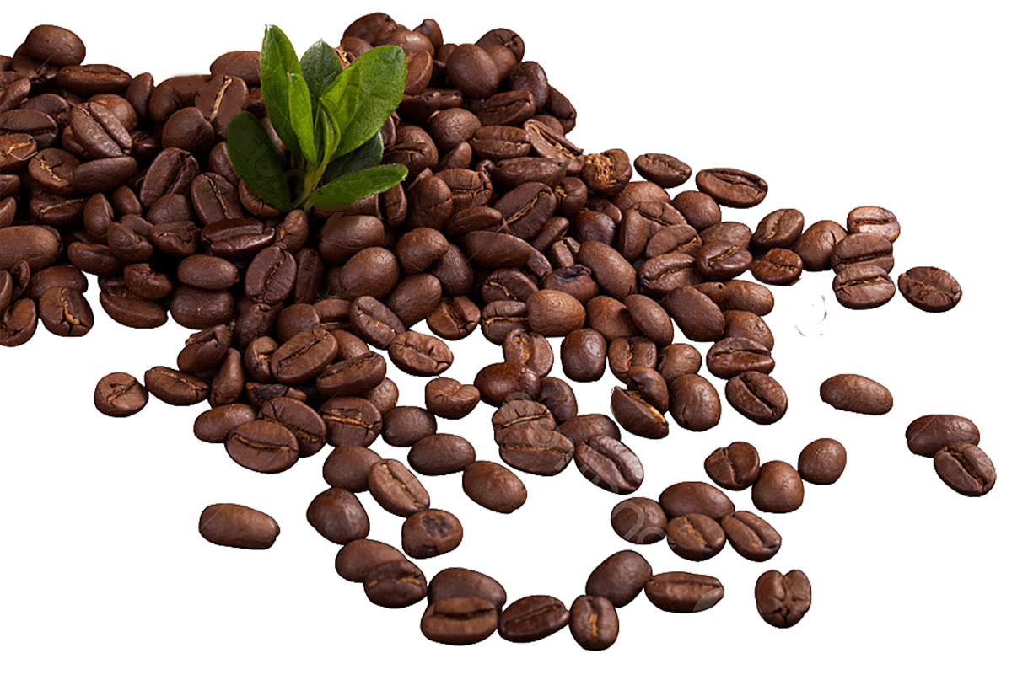
Is Arabica Coffee Better?
“Arabica coffee makes up 60% of the world's coffee, and coffee experts consider it the highest quality coffee variety. If you're looking for a sweet and flavorful coffee, especially one you plan to drink black, it is worth seeking out Arabica coffee beans.”
-homegrounds.com
“No contest! If you had to choose between an Arabica bean and a Robusta bean, it's essential to always choose Arabica! “
-roasterie.com

Slide 23
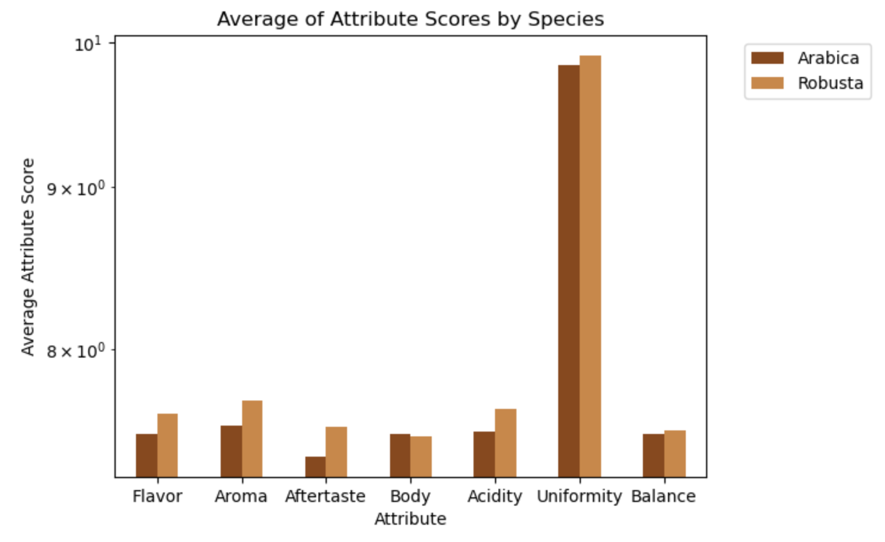
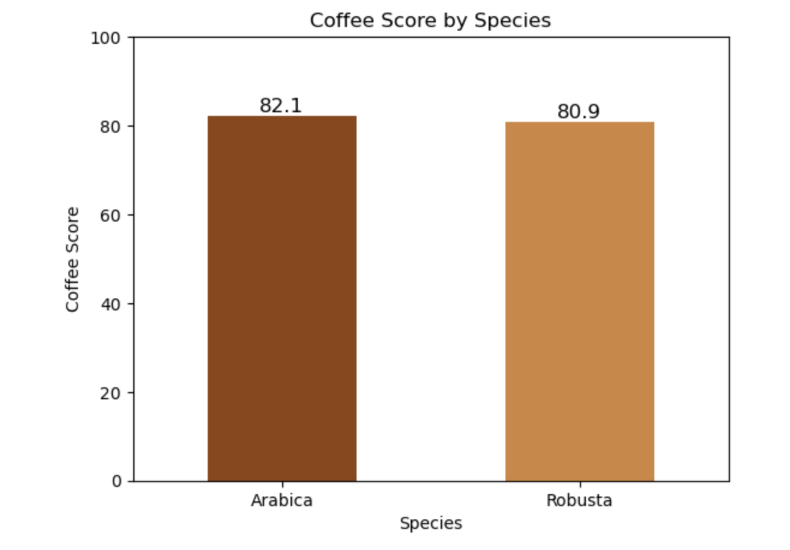
Overall Coffee Score is the same by species
Despite being known for having a harsher taste, single origin Robusta beans in our dataset scored higher for flavor, aroma, aftertaste and acidity

Slide 24
Key Takeaways
Colombia has the greatest number of high quality coffee producers
Colombian coffee quality is different from the rest of the world
Processing methods do not change the Aroma/Flavor/Body scores by much
However statistically, processing methods do impact flavor and body
Overall coffee scores for Arabica is higher than Robusta*
* May want to verify with a larger sample set of Robusta data

Slide 25

Notes:
Thank you! And I hope our presentation will give you insight into what to look for next time you’re shopping for the ultima

Slide 26
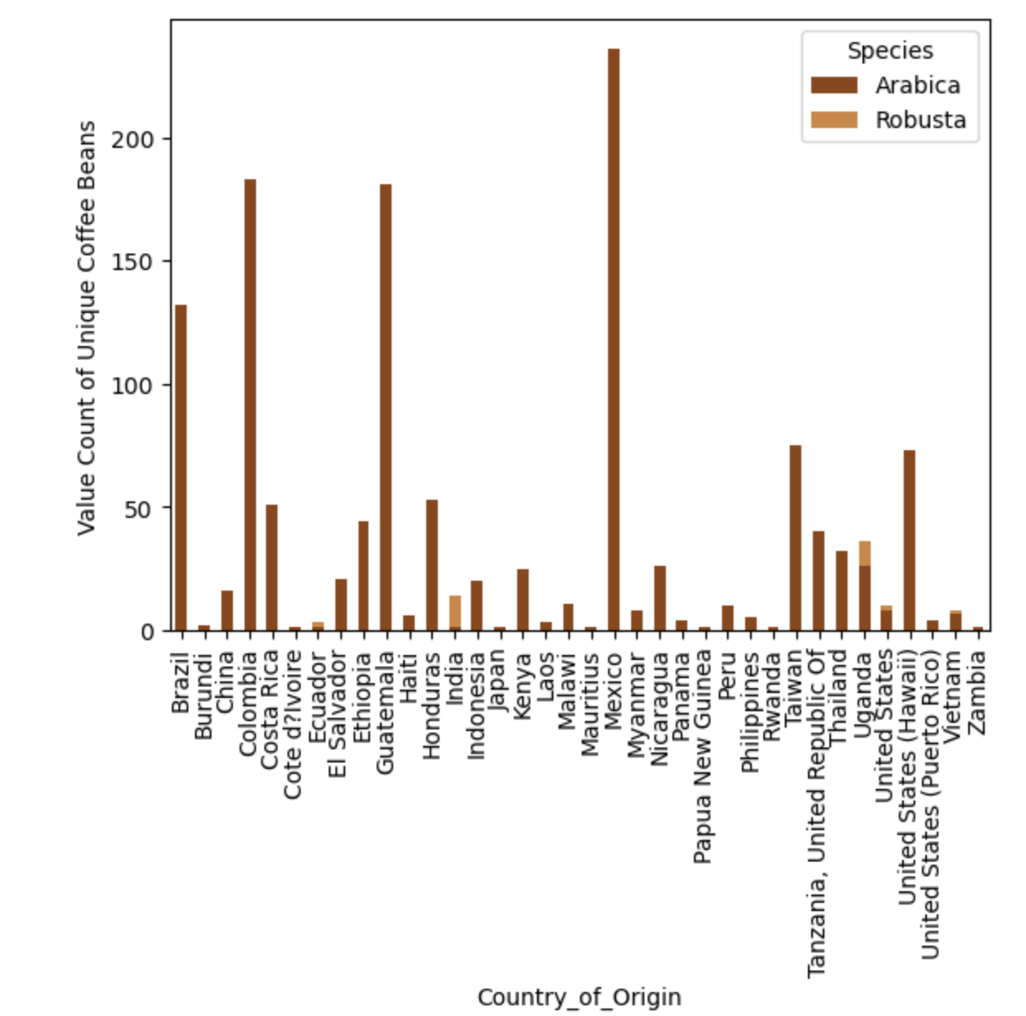
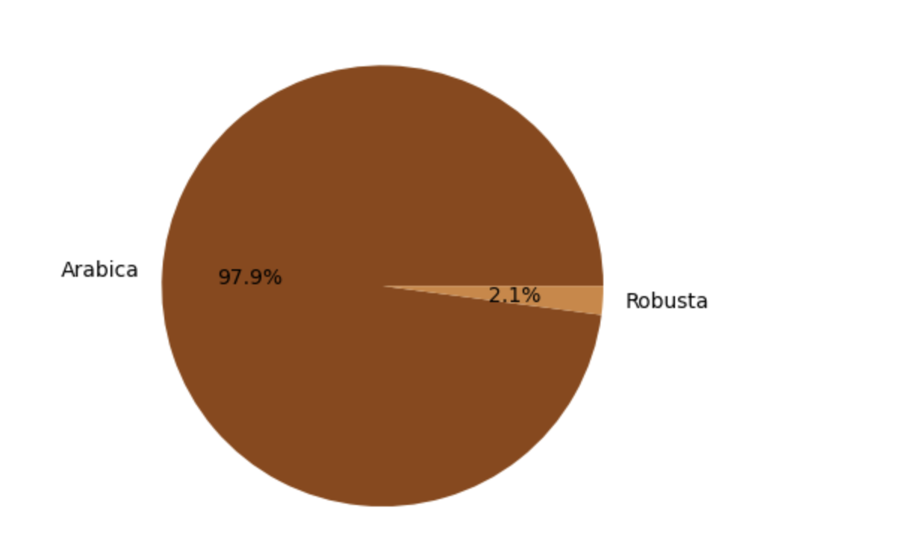
Most coffee beans are Arabica
Coffee bean distributors from all over the world produce Arabica, however 30%* of production is Robusta
While Arabica is produced all over the world, Robusta comes mostly from India and Uganda
% of coffee beans by species
*Andy Bunning Compound Interest 2018
https://www.compoundchem.com/2018/09/30/arabica-robusta/
Notes:
In our dataset, most coffee beans were Arabica. However we see from other sources that Robusta comprises 30% of the overall world production of coffee. Arabica can grow at a larger range of altitudes and is more expensive, while Robusta is known to have a harsher / more bitter flavor, and more caffeine. It is also often used for coffee blends, which could be a contributor to this discrepancy.
In part because of Arabica’s ability to grow at higher altitudes, Arabica comes from producers all over the world - with Mexico being the country with the highest number of unique bean types (accounting for 18% of the total). Robusta, on the other hand, mostly comes from India and Uganda.

